Slide 1
18-447 Computer Architecture Lecture 30: In-memory Processing
Vivek Seshadri
Carnegie Mellon University
Spring 2015, 4/13/2015

Slide 2
Goals for This Lecture
Understand DRAM technology
How it is built?
How it operates?
What are the trade-offs?
Can we use DRAM for more than just storage?
In-DRAM copying
In-DRAM bitwise operations

Slide 3
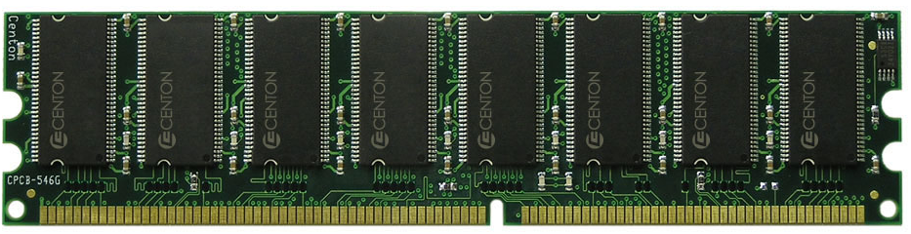
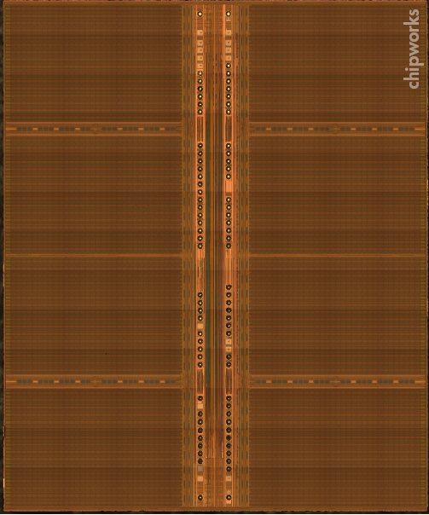
DRAM Module and Chip

Slide 4
Goals of DRAM Design
Cost
Latency
Bandwidth
Parallelism
Power
Energy
Reliability

Slide 5
DRAM Chip
Bank

Slide 6
DRAM Cell – Capacitor
Empty State
Fully Charged State
Logical “0”
Logical “1”
1
Small – Cannot drive circuits
2
Reading destroys the state

Slide 7
Sense Amplifier
top
enable
Inverter
bottom

Slide 8
Sense Amplifier – Two Stable States
V_{DD}
0
en
en
0
V_{DD}
Logical “1”
Logical “0”

Slide 9
Sense Amplifier Operation
V_{T}
V_{DD}
dis
V_{T} > V_{B}
en
V_{B}
0

Slide 10
Capacitor to Sense Amplifier
?
0
V_{DD}
en
en
V_{DD}
0

Slide 11
DRAM Cell Operation
½V_{DD}
½V_{DD}+δ
V_{DD}
Cell loses charge
Cell regains charge
dis
en
0
½V_{DD}

Slide 12
Amortizing Cost – DRAM Tile
Row Driver

Slide 13
DRAM Subarray
Row Decoder
Row Driver
Tile
Tile
Tile

Slide 14
DRAM Subarray
Row Decoder
Row Driver
Tile
Tile
Tile
Tile
Tile
Tile
Tile

Slide 15
DRAM Bank
Row Decoder
Cell Array
Array of Sense Amplifiers (8Kb)
Cell Array
Address
Row Decoder
Cell Array
Array of Sense Amplifiers
Cell Array
Bank I/O (64b)
Data
Address

Slide 16
DRAM Chip
Shared internal bus
Row Decoder
Cell Array
Row Decoder
Cell Array
Array of Sense Amplifiers (8Kb)
Array of Sense Amplifiers (8Kb)
Cell Array
Cell Array
Row Decoder
Cell Array
Row Decoder
Cell Array
Array of Sense Amplifiers
Array of Sense Amplifiers
Row Decoder
Cell Array
Row Decoder
Cell Array
Cell Array
Cell Array
Array of Sense Amplifiers (8Kb)
Array of Sense Amplifiers (8Kb)
Bank I/O (64b)
Bank I/O (64b)
Cell Array
Cell Array
Row Decoder
Cell Array
Row Decoder
Cell Array
Array of Sense Amplifiers
Array of Sense Amplifiers
Cell Array
Cell Array
Row Decoder
Cell Array
Row Decoder
Cell Array
Bank I/O (64b)
Bank I/O (64b)
Array of Sense Amplifiers (8Kb)
Array of Sense Amplifiers (8Kb)
Cell Array
Cell Array
Row Decoder
Cell Array
Row Decoder
Cell Array
Array of Sense Amplifiers
Array of Sense Amplifiers
Row Decoder
Cell Array
Row Decoder
Cell Array
Cell Array
Cell Array
Array of Sense Amplifiers (8Kb)
Array of Sense Amplifiers (8Kb)
Bank I/O (64b)
Bank I/O (64b)
Cell Array
Cell Array
Row Decoder
Cell Array
Row Decoder
Cell Array
Array of Sense Amplifiers
Array of Sense Amplifiers
Cell Array
Cell Array
Bank I/O (64b)
Bank I/O (64b)
Memory channel - 8bits

Slide 17
DRAM Operation
Row Decoder
ACTIVATE Row
1
Row Address
2
READ/WRITE Column
Row Decoder
Cell Array
Array of Sense Amplifiers
Cell Array
3
PRECHARGE
Bank I/O
Data
Column Address

Slide 18
Goals for This Lecture
Understand DRAM technology
How it is built?
How it operates?
What are the trade-offs?
Can we use DRAM for more than just storage?
In-DRAM copying
In-DRAM bitwise operations

Slide 19
Trade-offs in DRAM Design
Cost
Latency
Bandwidth
Parallelism
Power
Energy
Reliability
Rows/Subarray
Data width, Chips/DIMM
Banks/Chip

Slide 20
Goals for This Lecture
Understand DRAM technology
How it is built?
How it operates?
What are the trade-offs?
Can we use DRAM for more than just storage?
In-DRAM copying
In-DRAM bitwise operations

Slide 21



RowClone
Fast and Energy-Efficient In-DRAM Bulk Data Copy and Initialization
Vivek Seshadri
Y. Kim, C. Fallin, D. Lee, R. Ausavarungnirun,
G. Pekhimenko, Y. Luo, O. Mutlu,
P. B. Gibbons, M. A. Kozuch, T. C. Mowry
Notes:
Put down “Vivek”

Slide 22
Memory Channel – Bottleneck
Limited Bandwidth
Memory
Core
Cache
MC
Channel
Core
High Energy

Slide 23
Goal: Reduce Memory Bandwidth Demand
Memory
Core
Cache
MC
Channel
Core
Reduce unnecessary data movement

Slide 24
Bulk Data Copy and Initialization
Bulk Data Copy
src
dst
Bulk Data Initialization
dst
val

Slide 25
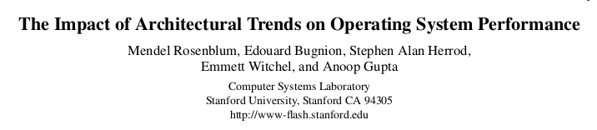
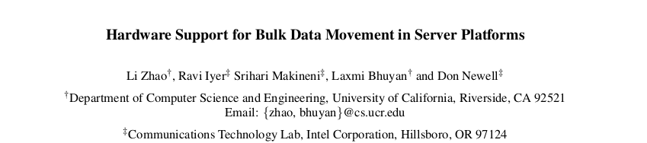
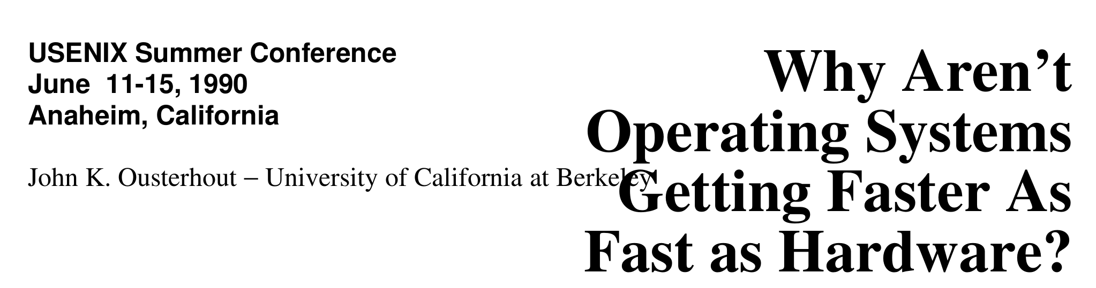
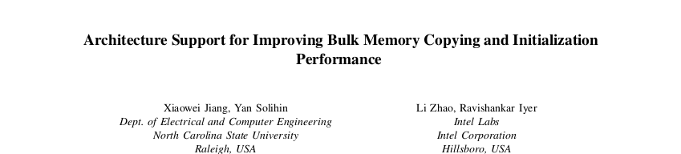
Bulk Data Copy and Initialization
Bulk Data Copy
src
dst
Bulk Data Initialization
dst
val

Slide 26

Bulk Copy and Initialization – Applications
000000000000000
Zero initialization
(e.g., security)
Forking
Checkpointing
Many more
VM Cloning
Deduplication
Page Migration

Slide 27
Shortcomings of Existing Approach
High Energy
(3600nJ to copy 4KB)
Core
Cache
Channel
dst
MC
Core
src
High latency
(1046ns to copy 4KB)
Interference
Notes:
1 micro second even with pipelining…

Slide 28
Our Approach: In-DRAM Copy with Low Cost
X
High Energy
Core
Cache
Channel
dst
MC
?
Core
src
X
High latency
X
Interference

Slide 29
RowClone: In-DRAM Copy

Slide 30
Bulk Copy in DRAM – RowClone
½V_{DD} +δ
½V_{DD}
V_{DD}
Data gets
copied
0
1
0
½V_{DD}

Slide 31
Fast Parallel Mode – Benefits
Bulk Data Copy (4KB across a module)
11X
74X
Latency
Energy
1046ns to 90ns
3600nJ to 40nJ
No bandwidth consumption
Very little changes to the DRAM chip

Slide 32
Fast Parallel Mode – Constraints
Location constraint
Source and destination in same subarray
Size constraint
Entire row gets copied (no partial copy)
Can still accelerate many existing primitives
(copy-on-write, bulk zeroing)
1
2
Alternate mechanism to copy data across banks
(pipelined serial mode – lower benefits than Fast Parallel)

Slide 33
End-to-end System Design
Software interface
memcpy and meminit instructions
Managing cache coherence
Use existing DMA support!
Maximizing use of Fast Parallel Mode
Smart OS page allocation

Slide 34
Applications Summary

Slide 35
Results Summary

Slide 36
Goals for This Lecture
Understand DRAM technology
How it is built?
How it operates?
What are the trade-offs?
Can we use DRAM for more than just storage?
In-DRAM copying
In-DRAM bitwise operations

Slide 37
Triple Row Activation
½V_{DD}
½V_{DD}+δ
V_{DD}
A
Final State
AB + BC + AC
B
C
C(A + B) + ~C(AB)
dis
en
0
½V_{DD}

Slide 38
In-DRAM Bitwise AND/OR
Required Operation: Perform a bitwise AND of two rows A and B and store the result in C
R0 – reserved zero row, R1 – reserved one row
D1, D2, D3 – Designated rows for triple activation
RowClone A into D1
RowClone B into D2
RowClone R0 into D3
ACTIVATE D1,D2,D3
RowClone Result into C

Slide 39
Throughput Results
L1
L2
L3
Memory

Slide 40
Bitmap Index
Alternative to B-tree and its variants
Efficient for performing range queries and joins
age < 18
18 < age < 25
25 < age < 60
age > 60
Bitmap 1
Bitmap 2
Bitmap 3
Bitmap 4

Slide 41
Performance Evaluation

Slide 42
Goals for This Lecture
Understand DRAM technology
How it is built?
How it operates?
What are the trade-offs?
Can we use DRAM for more than just storage?
In-DRAM copying
In-DRAM bitwise operations

